Slide 1
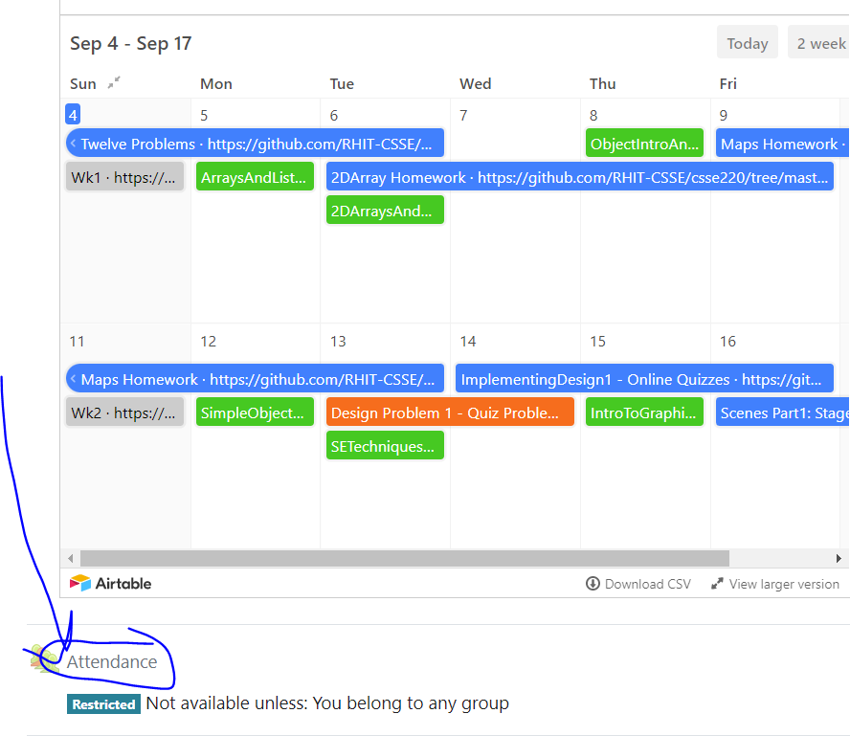
CSSE 220
Today’s Attendance password
__________
Primitive Types: Part1-JavaPrimitiveTypes.pptx
Arrays: Part2-JavaBuiltInArrays.pptx
ArrayLists: Part3-JavaArrayLists.pptx
The git projects for today are:
PracticeArrayList
PracticeArrayListSolution
The Quiz for today is
ArraysAndListsQuiz
Notes:
JAY: Introduce FIRST row today (Identity Pie)
Aim to have them working on arrays in the 1st hour and arraylists in the second hour

Slide 2
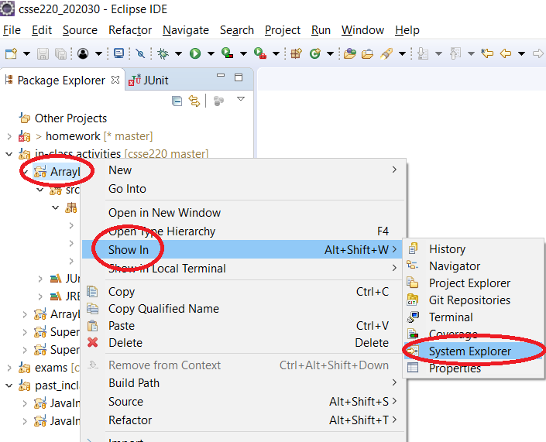
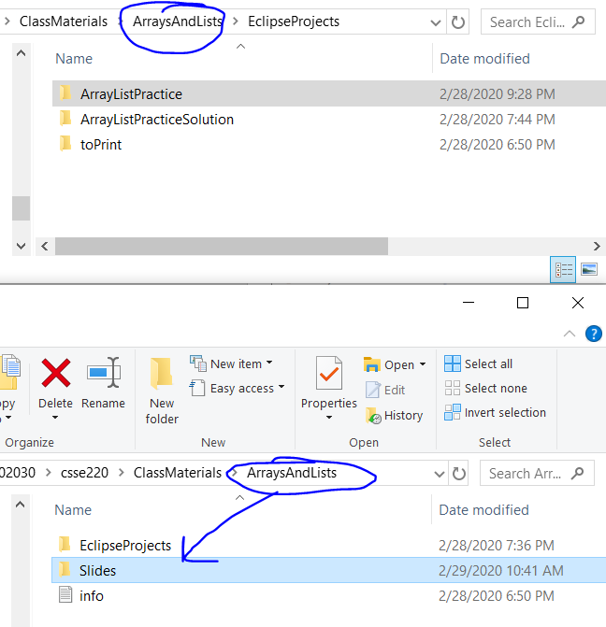
How to access slides (from Eclipse)

Slide 3
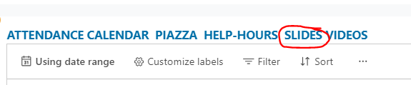
How to access slides (from Internet)

Slide 4
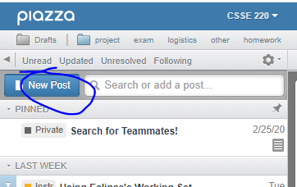
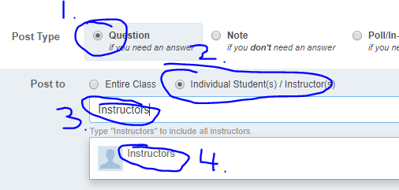
Questions: Post to Piazza
PLEASE Post All Questions to Piazza
If asking a question about an individual assignment (i.e. Homework) and you must share code (Homework) to ask your question:
Email instructors ONLY (see below)
Otherwise: please post questions and look to help provide hints to other students
Collaborative (i.e., in-class activities) or if you don’t have to post code to ask the question
Notes:
Emphasize to the students that if they feel overwhelmed they are not alone!
Remind them to ask questions and that as a class we can go slower if we need to.
As a rule: students really struggle with the enhanced for loop, if there are no questions, people may be scared to ask.
Other topics student are likely to be confused at this point:
different between primitives and classes/objects
the idea that memory stores information somewhere and it effectively is an address (null) for objects
public vs. private: could create a little demo class (Person) to show getter and setters with private/public variables (name)
Person p1 = new Person(“Jason”); p1.name p1.getName()

Slide 5
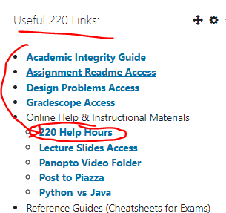
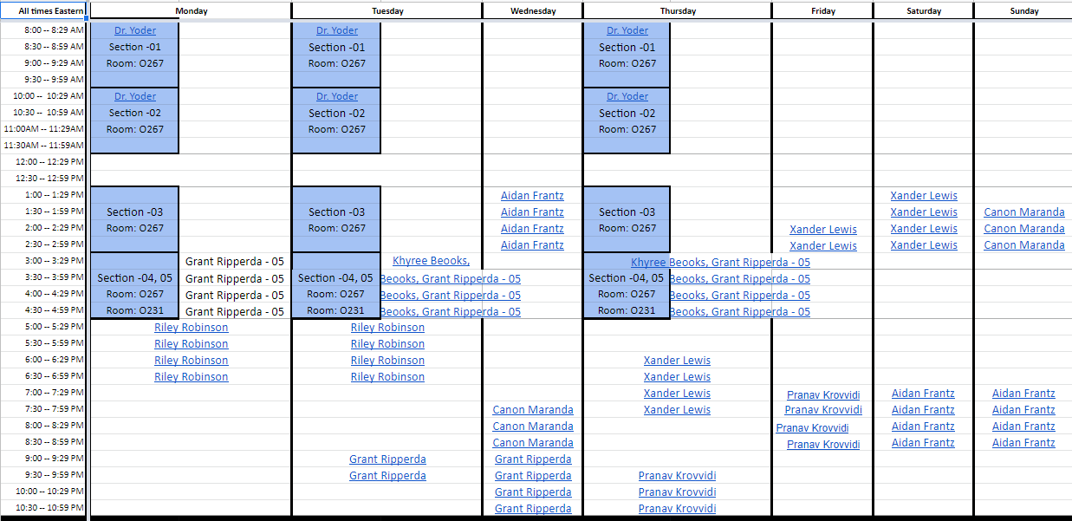
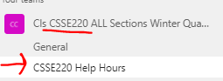
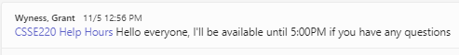
TA Help Hours
Linked from Moodle
Click on links in sheet
Opens MS Team Channel
Send message, then video call/screen share w/ TA
Notes:
Emphasize to the students that if they feel overwhelmed they are not alone!
Remind them to ask questions and that as a class we can go slower if we need to.
As a rule: students really struggle with the enhanced for loop, if there are no questions, people may be scared to ask.
Other topics student are likely to be confused at this point:
different between primitives and classes/objects
the idea that memory stores information somewhere and it effectively is an address (null) for objects
public vs. private: could create a little demo class (Person) to show getter and setters with private/public variables (name)
Person p1 = new Person(“Jason”); p1.name p1.getName()

Slide 6
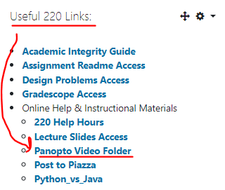
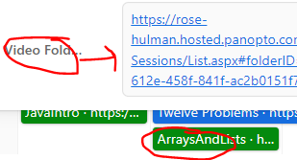
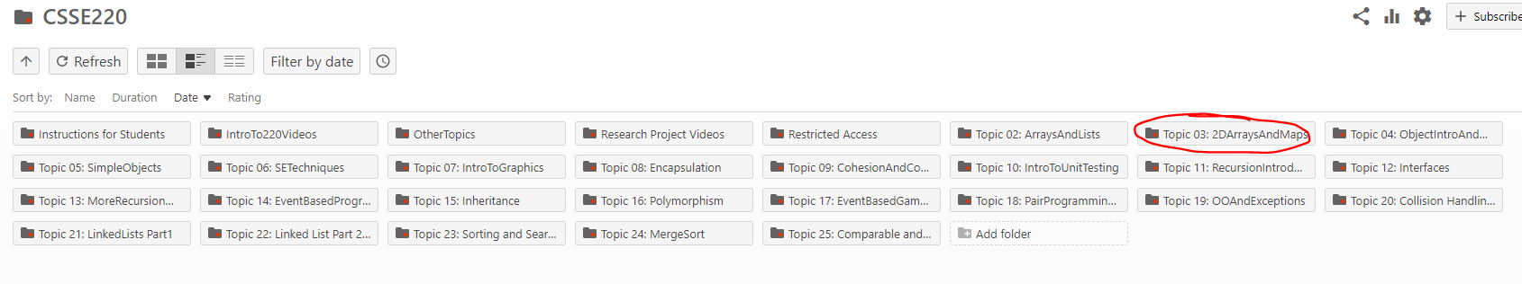
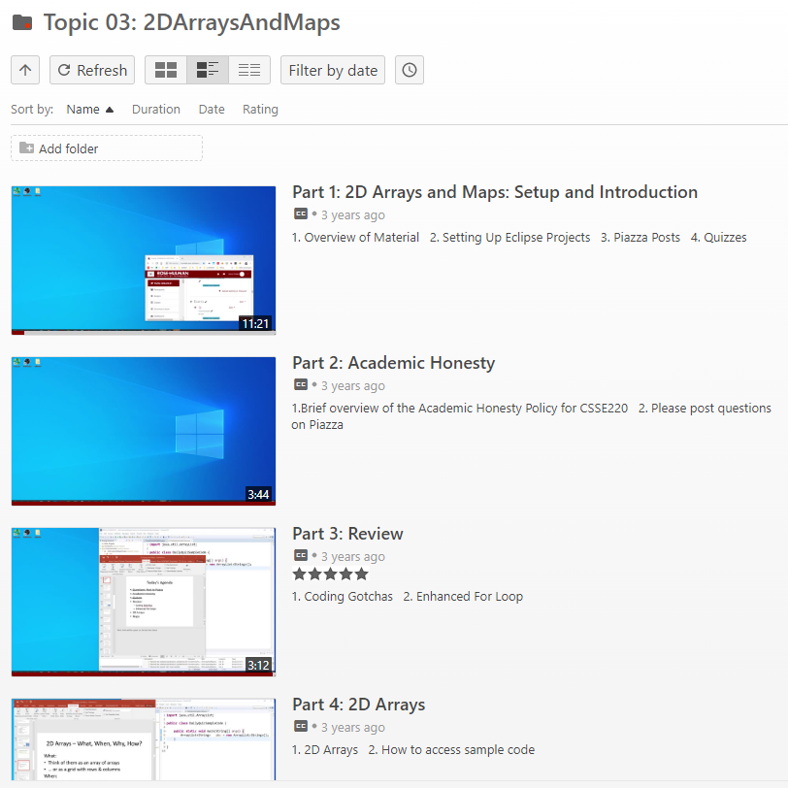
Panopto Videos
Videos cover the content, sometimes slightly different, but always an options for extra review and practice

Slide 7
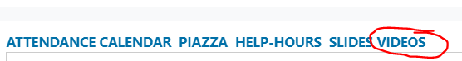
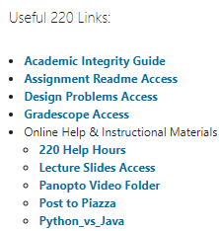
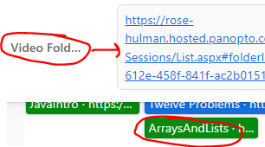



Speed With Which Things Move
Moving up a level in speed
Anticipate as time allows:
Go through slides before class
Familiarize yourself with terminology
Write down questions for instructor
Ask questions in class, or hand piece of paper with questions to instructor at beginning of class
Read the Big Java chapters
Watch pre-recorded videos

Slide 8
Getting things done
If something has a hard deadline, then set a reminder in your smart device
Live by: “if I don’t do it now, it won’t get done”
Speaking of which… HW1…
Notes:
Go over solution from HW1 to make sure students get the answer
intentionally introduce error in HW1 as you go. order of operations. different approaches.

Slide 9
JavaIntro, HW1, TwelveProblems
Any questions: feel free to ask individually
JavaIntro will not be collected and graded
Intended to help you learn
Not intended as busy work
TwelveProblems
Due date on schedule page
First half you can probably do already

Slide 10
Syllabus Highlights

Slide 11
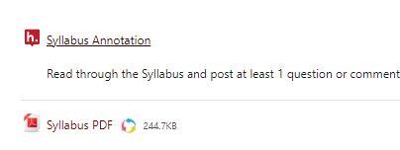
Syllabus Highlights
Course policies
Late Assignments
Grading
Collegiality
Schedule
Etc.

Slide 12
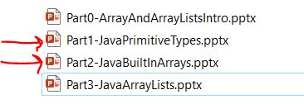
Plan for remainder of 1st hour
I lecture over BRIEFLY over these two slides
You read through them in more detail as needed (please ask questions during lecture or when reading)
Work time on practice problems for arrays

Slide 13
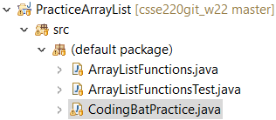

Array Practice Opportunity
Form groups of 2
Navigate to: http://codingbat.com/java/Array-2
Work in your groups to solve: fizArray3, bigDiff, shiftLeft
If you finish early, try: zeroFront
Save your codingbat work by copy and paste into CodingBatPractice.java

Slide 14
Work Time
Completing the Array Practice
Complete Daily Quiz
Looking at ArrayList Slides OR TwelveProblems
Notes:
As time allows:
1. See if anyone is asking about static, give simple explanation
2. Possible elaborate on an auto-boxing diagram

Slide 15
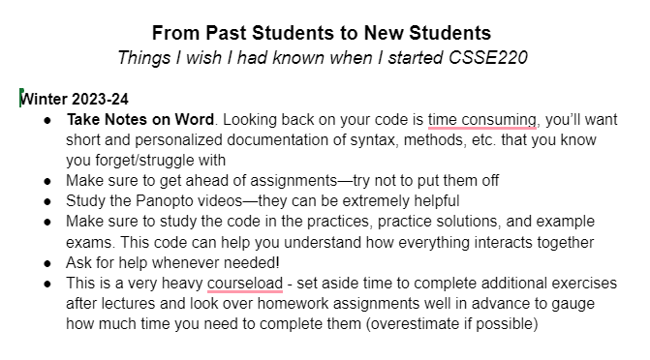
Advice from Former Students
https://docs.google.com/document/d/1gWrR8fe7Qs5B9MgRkFW4wBa-tnRdFXGTDRnqi2ps1i4/edit

